Slide 1
In this segment
Messaging Systems
Basic Concepts
Message Channel
Message
Pipes and Filters
Message Router
Message Translator
Message Endpoint

Slide 2
Messaging Systems
Basic Concepts
Channel – A virtual pipe that connects sender and receiver
Message – Atomic packet of data transmitted through a channel
Multi-step Delivery – Architecture that’s used to send data across the remote network
Routing - Process of navigating the channel topology to get the message from sender to receiver
Transformation – Process of adapting data to a format accepted over the network in question
Endpoint – A logical port on the channel/system where the message is directed to, to reach with the destination/receiver application

Slide 3
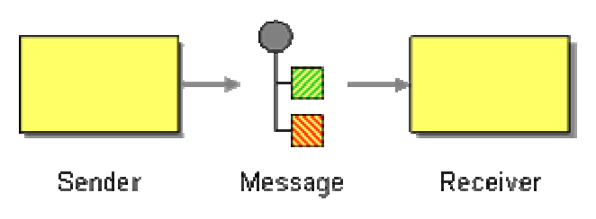
Messaging Systems
Message
Unit of data that’s transmitted between sender/receiver
Consists of:
Header - Information used by the messaging system that describes the data being transmitted
Body - The actual data being transmitted
Message sequence – Used if the data can not be fit into a single message
Types of messages – Command, Data, Event etc.
Formats: JMS Message, SOAP Message, .NET Message etc.
JMS Message – Represented by type “Message”
TextMessage
ByteMessage
ObjectMessage
StreamMessage
MapMessage

Slide 4
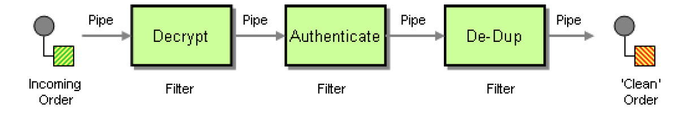
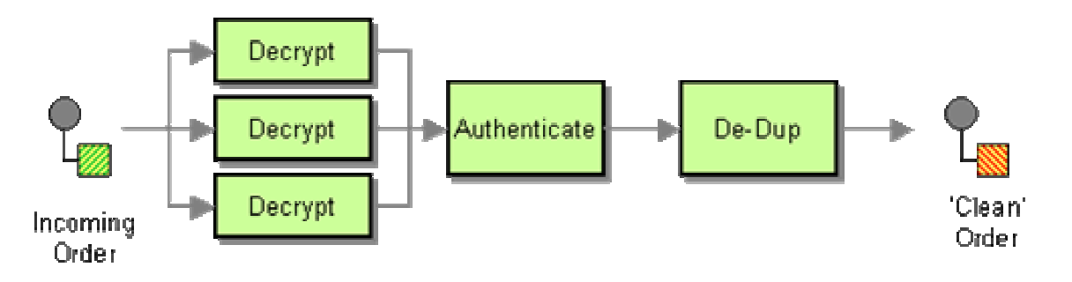
Messaging Systems
Pipes and Filters
Used to divide a larger processing task into a sequence of smaller, independent processing steps (Filters) that are connected by channels (Pipes)
Pipe uses Message Channel or in-memory queue as implementation
Allows pipeline processing to cater to volume and speed
Parallel processing of messages at a particular layer can be performed using multiple parallel filters at the bottleneck

Slide 5
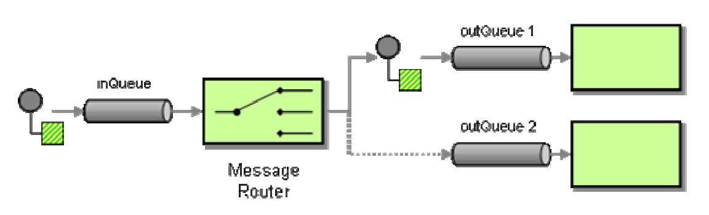
Messaging Systems
Message Router
Message Router is a special filter which consumes a Message from one Channel and republishes it to a different channel depending on a set of conditions
Represents single place to maintain decision logic for message routing
Can act as a load balancer as well
Types
Content based Router
Context based Router

Slide 6
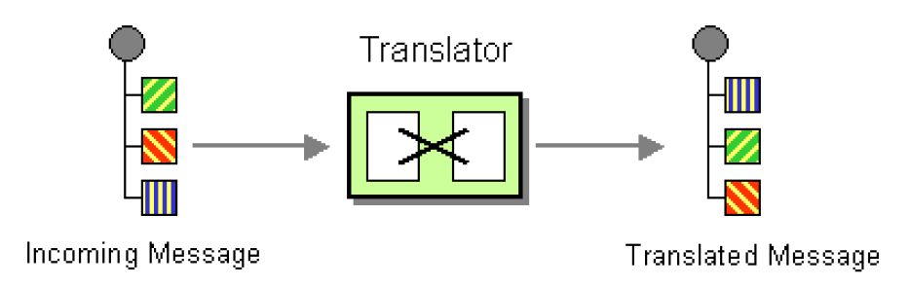
Messaging Systems
Message Translator
Message Translator, is a special filter between other filters or applications to translate one data format into another
Equivalent to “adapter” pattern of GoF patterns
Decouples from data format dependency
Message Translation Levels:
Data structures
Data types
Data representation
Transport

Slide 7
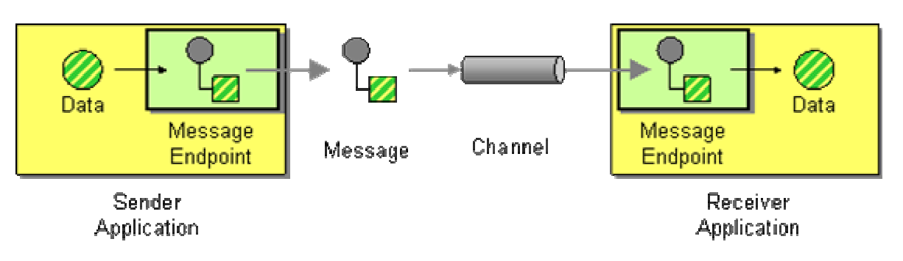
Messaging Systems
Message Endpoint
Message Endpoint is a client of the messaging system that can be used to connect application to the message channel, to send messages
Message Endpoint code is custom to both the application and the messaging system’s client API
Encapsulates the messaging system from the rest of the application, and customizes a general messaging API for a specific application and task
One instance of Endpoint can be used to either send or receive messages, not both
JMS Implementation – MessageProducer, MessageConsumer

